Slide 1

Apache Spark and Cloud Computing

Slide 2
What we learn today?
Overview of Spark?
Apache Spark Features
?
Why Apache
Spark?
Apache Spark Ecosystem
Databricks
And Spark

Slide 3

Big Data Analytics?
Big Data Analytics is the process of examining large data sets to uncover hidden patterns.
Big Data Analytics is of two types:
Batch Analytics
Real-time Analytics

Slide 4
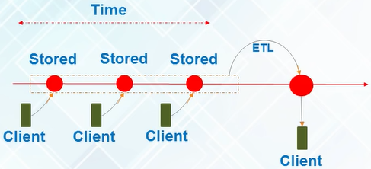
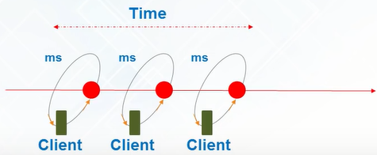
Batch vs Real Time Analytics?
Analytics based on the data collected over a period of time is Batch Analytics
Analytics based on immediate data for instant results is Real Time (Stream) analytics)

Slide 5
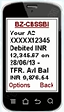




Use Cases of Real Time Analytics
Banking
Governments
Healthcare
Telecommunications
Stock Market

Slide 6
What is Spark?

Slide 7
Spark Background
Amplab UC Berkley
Project Lead: Dr. Matei Zaharia
First paper published on RDD’s was in 2012
Open sourced from day one
Databricks company established to support Spark and its related technologies. Matei currently CTO.
Databricks work with Amazon and Azure

Slide 8
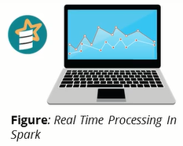
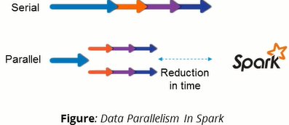
What is Spark?
Apache Spark is an open-source cluster-computing framework for real time processing.
Spark provides an interface for programming entire clusters with implicit data parallelism and fault-tolerance
It was build on top of Hadoop MapReduce and it extends the MapReduce model to efficiently use more types of computations

Slide 9
Why Spark
When Hadoop Already there?

Slide 10
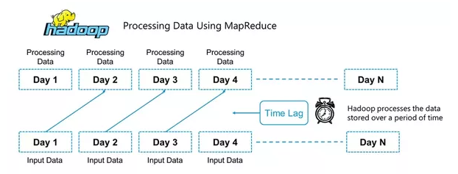
Batch Processing in Hadoop

Slide 11
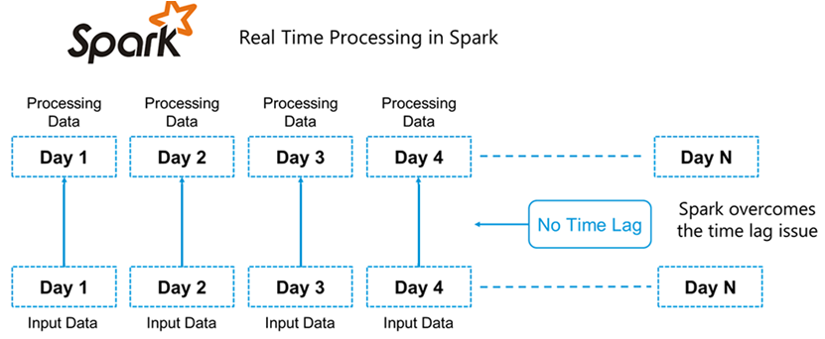
Real Time Processing in Spark

Slide 12
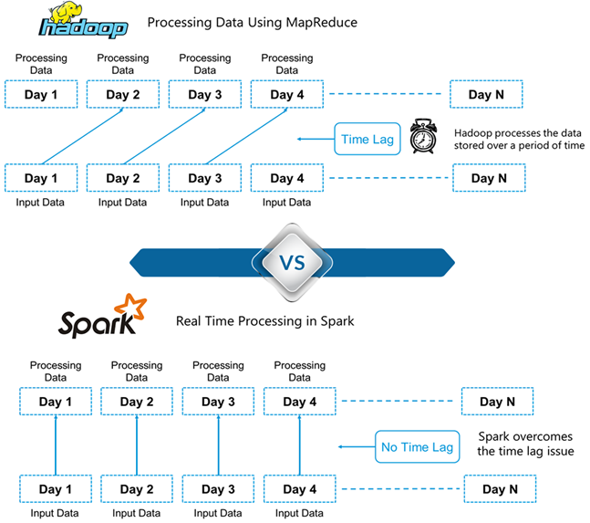
Hadoop vs Spark

Slide 13
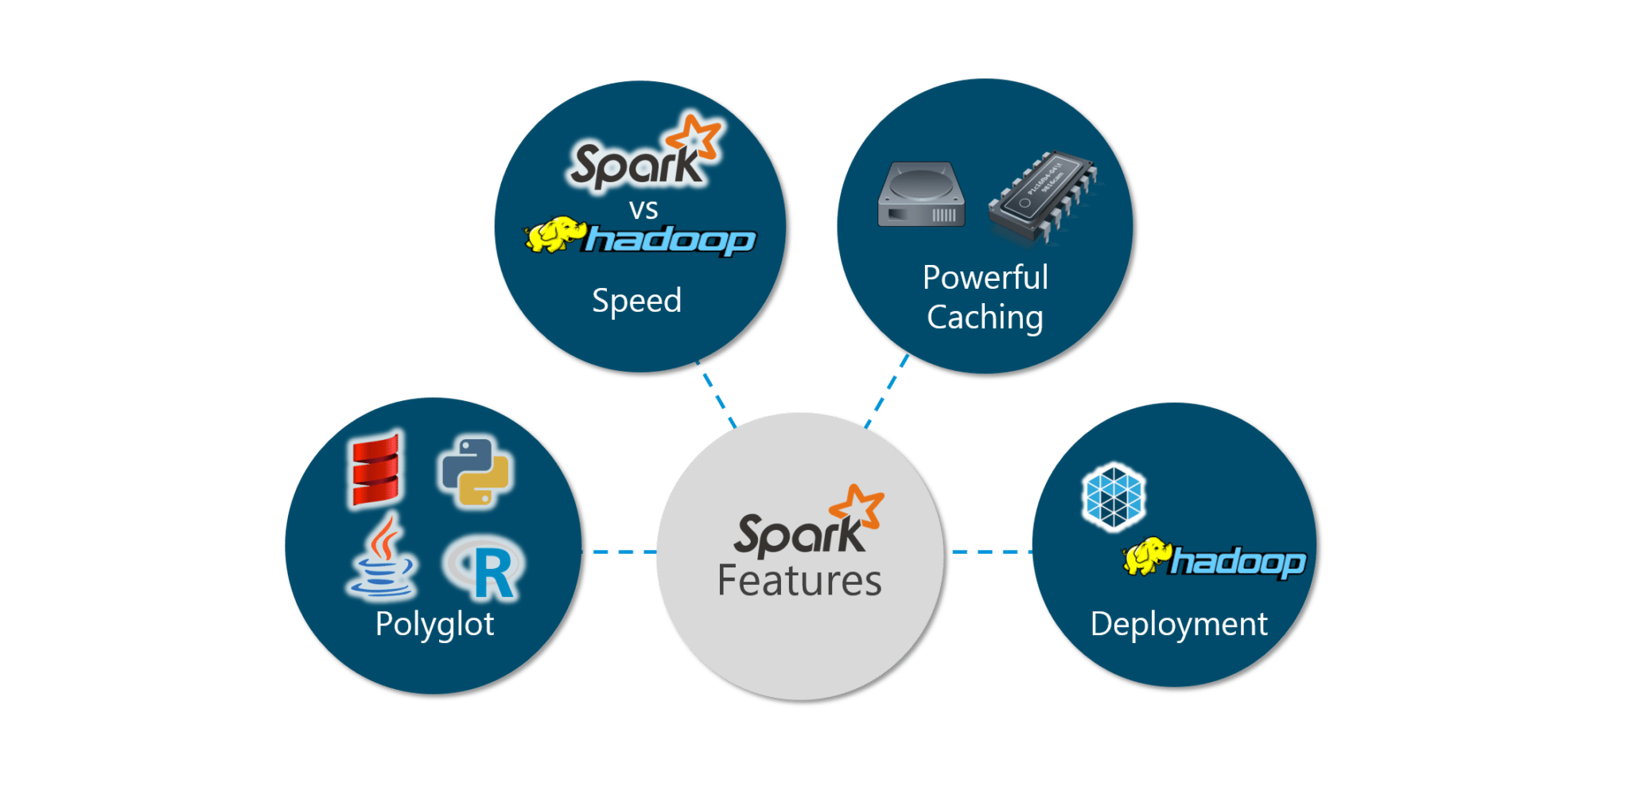
Why Spark?
Simple programming layer provides powerful caching and disk persistence capabilities
100x faster than for large scale data processing
Can be deployed through Mesos, Hadoop via Yarn, or Spark’s own cluster manager
Can be programmed in Scala, Java, Python and R

Slide 14




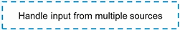



Hadoop vs Spark
Hadoop implements Batch processing on Big Data.
It thus cannot deliver to our Real-Time use case needs
Lets take a look!

Slide 15
Spark Success Story?

Slide 16

Spark Success Story

Slide 17
Using Hadoop through
Spark?

Slide 18
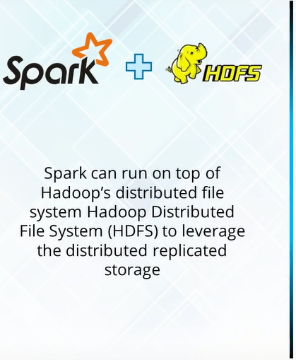
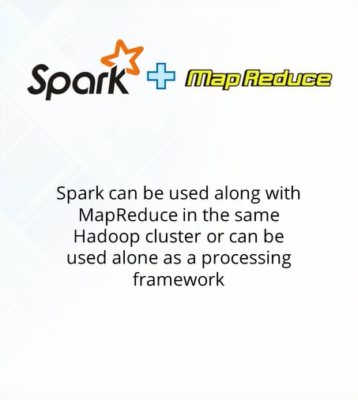
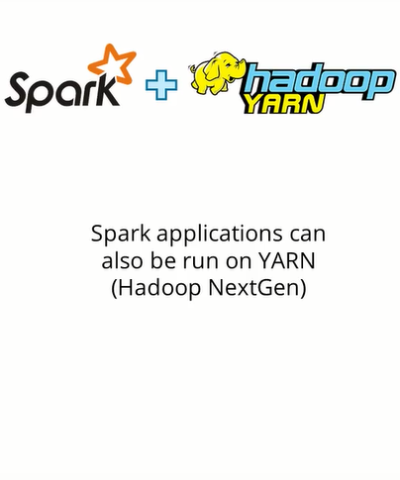
Spark and Hadoop

Slide 19
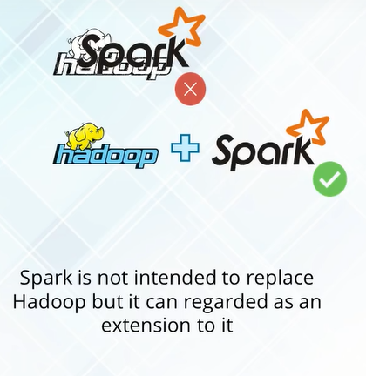
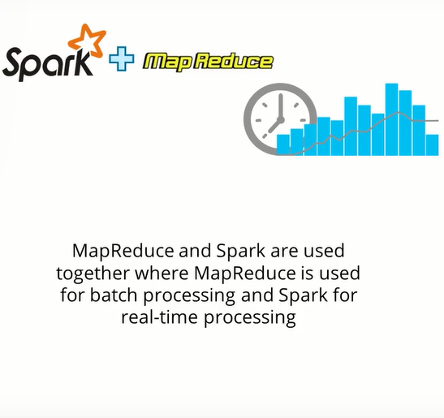
Spark and Hadoop

Slide 20
Spark Features
Speed
Polyglot
Advanced Analytics
In-Memory Computation
Hadoop Integration
Machine Learning

Slide 21
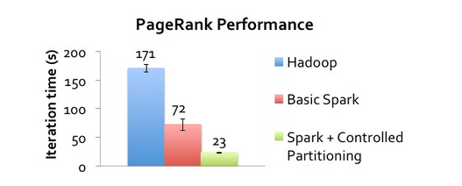

Spark Features
Spark runs up to 100x times faster than MapReduce
Polyglot: Programming in Scale, Python, Java, & R

Slide 22

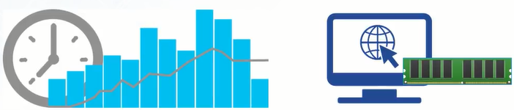
Spark Features
Lazy Evaluation: Delays evaluation till needed
Real time computation & low latency because of in-memory computation

Slide 23
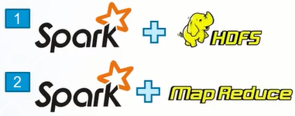

Spark Features
Hadoop Integration
Machine Learning for Iterative tasks

Slide 24
Spark Ecosystem
Spark Core
Spark Streaming
Spark SQL
MLlib
GraphX

Slide 25
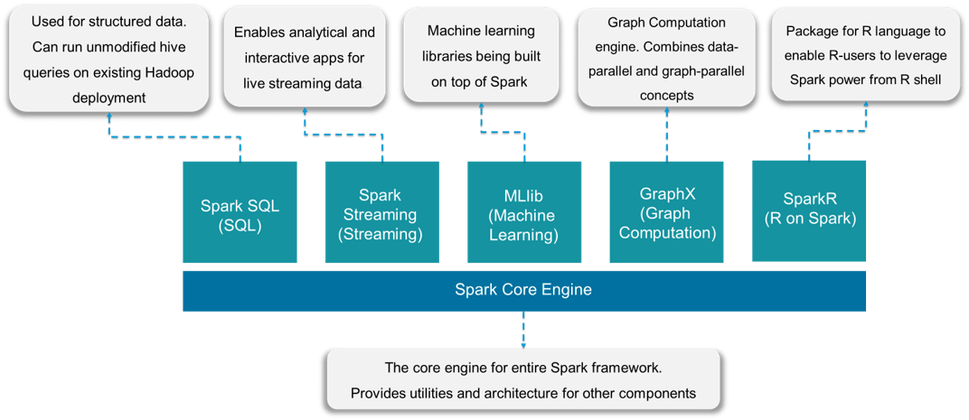
Spark Ecosystem

Slide 26
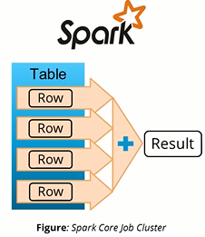
Spark Core
Spark Core is the base engine for large-scale parallel and distributed data processing
It is responsible for:
Memory Management and fault recovery
Scheduling, distributing and monitoring jobs
Interacting with storage systems

Slide 27
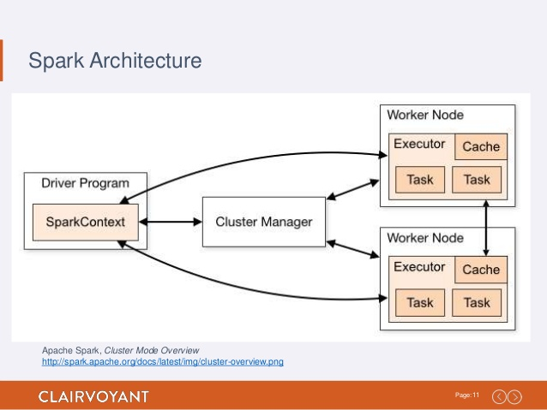
Spark Core

Slide 28
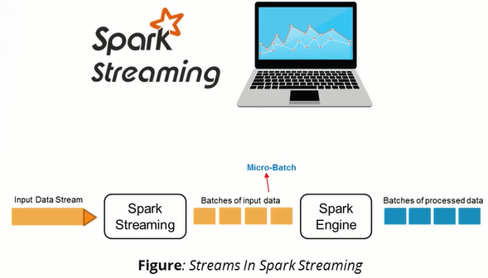
Spark Streaming
Spark Streaming is used to processing real-time streaming data
It is a useful addition to the core Spark API
Enables high-throughput and fault-tolerant stream processing of live data streams
The fundamental stream unit is Dstream which is basically a series of RDDs to process the real-time data

Slide 29
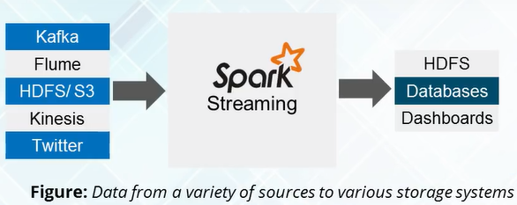
Spark Streaming

Slide 30
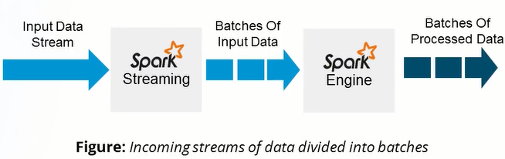
Spark Streaming

Slide 31
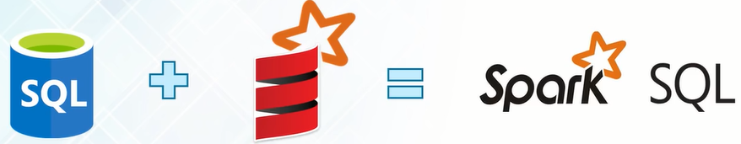

Spark SQL
Spark SQL integrates relational processing
Spark SQL is used for the structured/semi structured data

Slide 32
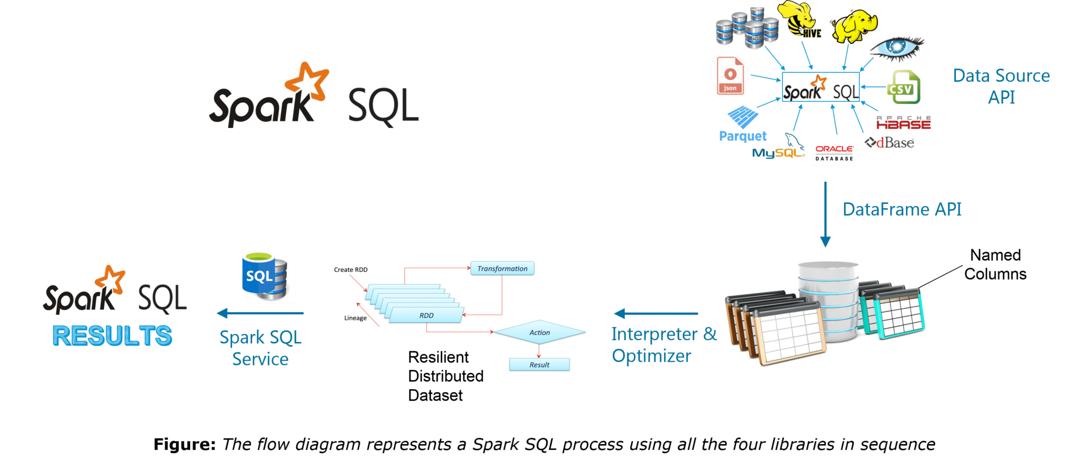
Spark SQL flow diagram

Slide 33
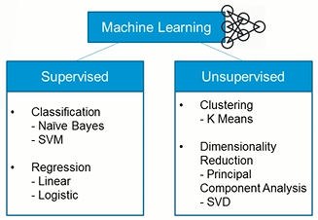
Spark MLlib

Slide 34
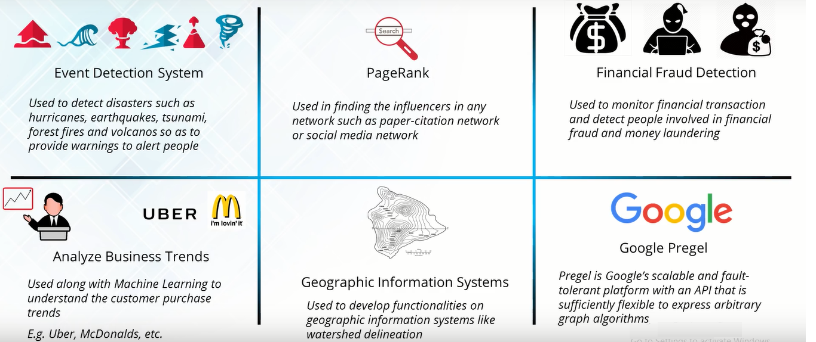
Spark GraphX

Slide 35
What is Databricks?

Slide 36
Thank You!
☺

